Slide 1
University Admission System
(UAS)
GROUP 3
Mentor
Tanmaya Acharya
Notes:
Add instructor notes here.

Slide 2
Objectives
Project Understanding
Approach used
Project Execution
Modules
Learning
Best Practices
Opportunity for improvement
Demo and Code Walkthrough
Q&A
Notes:
Add instructor notes here.

Slide 3
Project Understanding
The main objective of this project is to design and develop a University Admission System.
University Admission System is used to manage the admission procedure for the university online.
This is an integrated system that contains three main roles:
i. Applicant
ii. Admin
iii. Member of Admission Committee (MAC)

Slide 4
Project Understanding (Continued)
Applicant
Can view/apply programs scheduled.
View the application status, based on the application ID.
Member Of Admission Committee (MAC)
Can Login into the system.
View applications for a specific program.
Accept/Reject an application.
Update the status of the application.

Slide 5
Project Understanding (Continued)
Admin
Login to the system.
Update and manage (add or delete) information of the programs.
Manage (add or delete) schedules of the programs offered.
Generate various reports like:
> View List of applicants confirmed/ accepted (waiting for
interview)/rejected for a scheduled program.
> View list of programs scheduled to commence in a given
time period.

Slide 6
Approach used :
Front End & Web Components:–
> HTML/JavaScript
> CSS
> JSP
Business Logic Components and Services :-
> Java Beans
Application Servers:-
> WildFly
Databases:-
> Oracle 10g
Framework:-
> Spring
> JPA Hibernate 3.0

Slide 7
Project Execution
Admin Module
Applicant Module
Member of Admission Committee (MAC) Module

Slide 8
Admin Module
Update and manage (add or delete) information of the programs:
The admin can add programs offered by the university by entering the
programs details.
He may update or delete the programs offered by the university.
Manage (add or delete) schedules of the programs offered:
The admin can schedule the programs offered by the university.

Slide 9
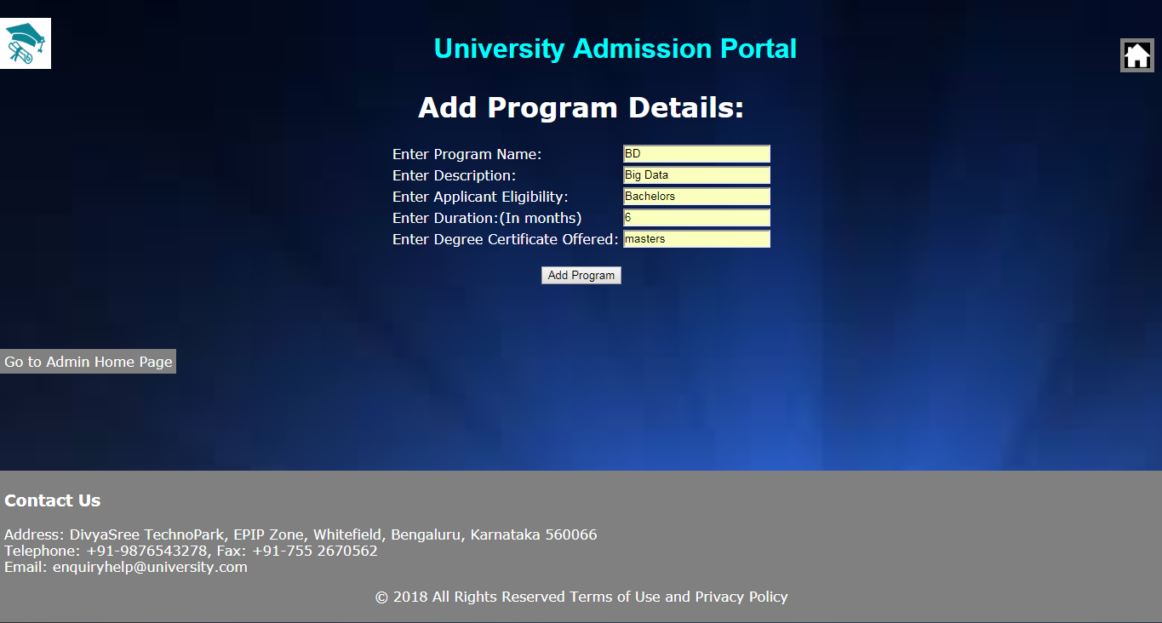
Admin Module

Slide 10
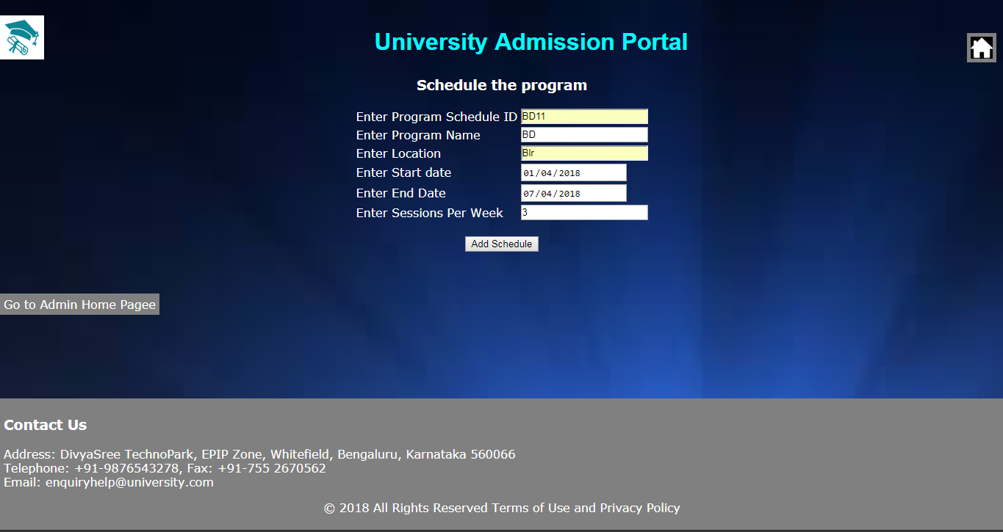
Admin Module

Slide 11
Admin Module
Generate various reports:
The admin can view the list of confirmed or accepted applicants.
He/she can also view the list of scheduled programs commencing
between two given dates.

Slide 12
MAC Module
View applications for a specific program:
MAC needs to select the program for which he/she wants to view the
applicants. The list of applicants for the particular will be displayed.
Accept/Reject an application:
Once the list of applicants is displayed, options for accepting/ rejecting
the applicant will be present corresponding to each applicant. The MAC
needs to accept/reject.
On accepting the applicant, MAC will be required to enter an interview
date.

Slide 13
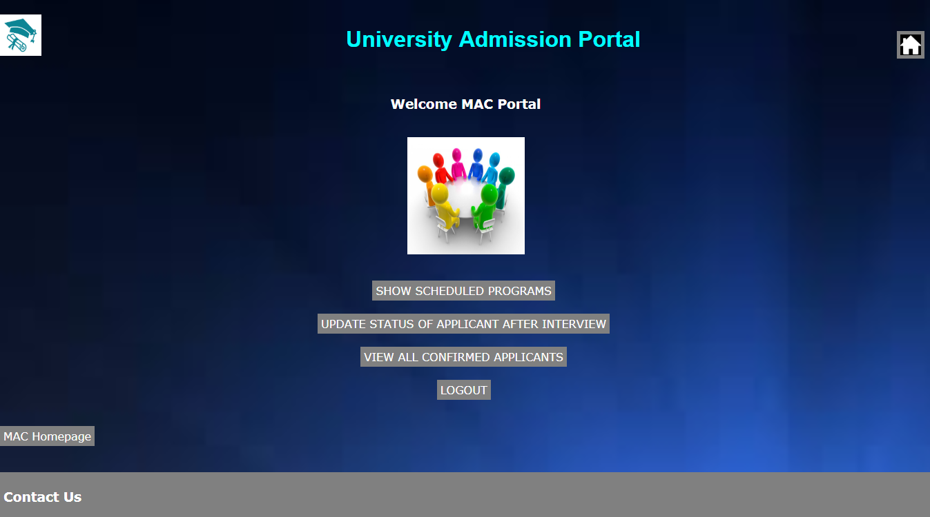
MAC(continued..)

Slide 14
MAC Module
Updating the status of the applicant:
After the interview has been conducted, MAC can confirm/reject the
applicant. On confirming the applicant, he will be added for the
particular course for which he had applied.

Slide 15
Applicant module
Can view/apply programs scheduled:
The applicant can view the list of programs offered by the university.
He/she can apply for a particular course without login.
He/she can apply for the desired scheduled program from the above list
post entering the details.
View the application status, based on the application ID:
The applicant can view the status of his application based on his
application ID.

Slide 16
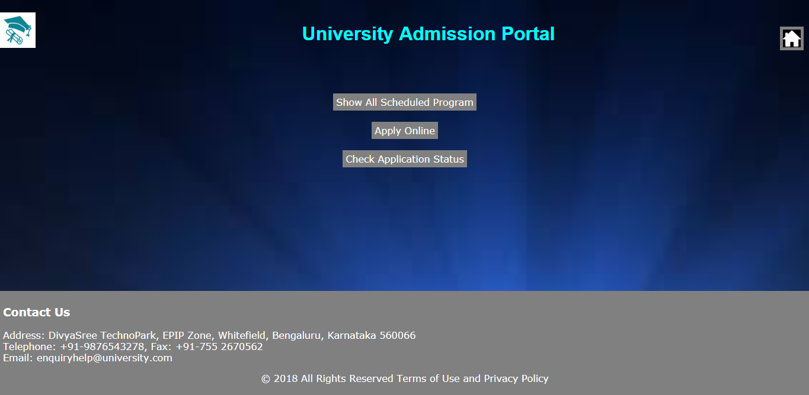
Applicant Module

Slide 17
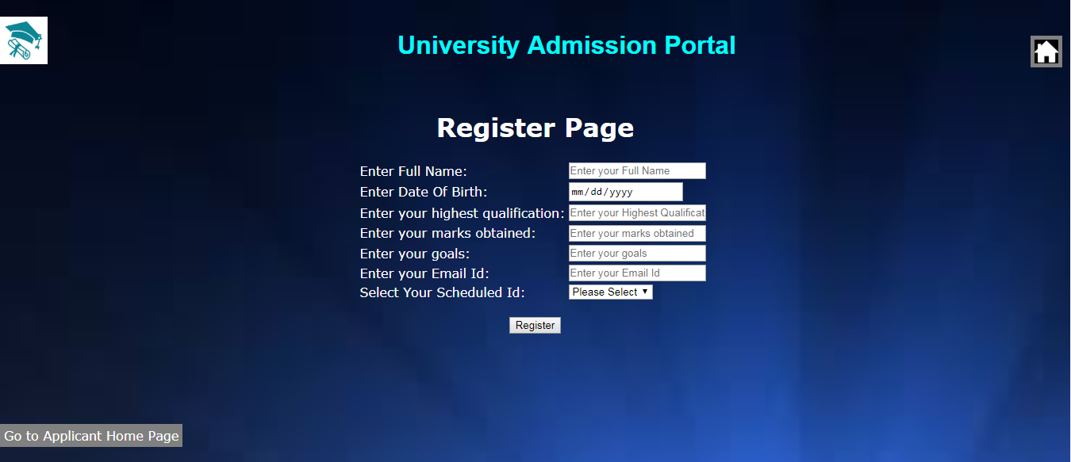
Applicant Module

Slide 18
Best Practices
Followed placing comments in appropriate places
Followed naming conventions.
Followed proper indentation.

Slide 19
Opportunity for improvement
Provision can be made for carrying out fee transactions for the programs.
A counselling platform can be made for assistance of the applicants.
A notice board can be added to display all the important information and recent happenings of the university.

Slide 20
THANK YOU

